Slide 1
Welcome to our presentation
Squad Ghouls

Slide 2
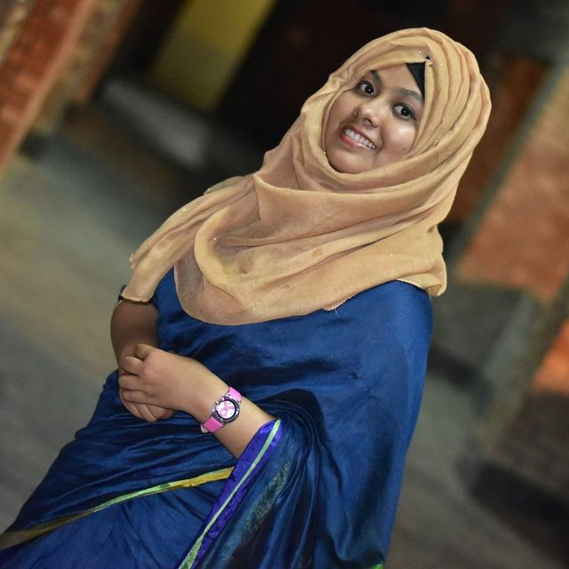

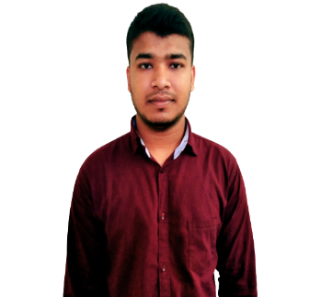
Presented to:
Shifat Jahan Setu
Lecturer
Dhaka International University
Subject name: Graphics and Multimedia
Subject code: CSE-406
Md Mejbah Uddin
Batch:52(1st Shift)
Roll:43
Presented by:
Md Sadiul Haque
Batch:53(1st Shift)
Roll:45

Slide 3

Some languages are used on this website
HTML 54.1%
CSS 37.5%
JavaScript 6.9%
PHP 1.5%

Slide 4






6 part of this site
Home
About us
Service
Portfolio
Team
Contacts

Slide 5


HOME

Slide 6

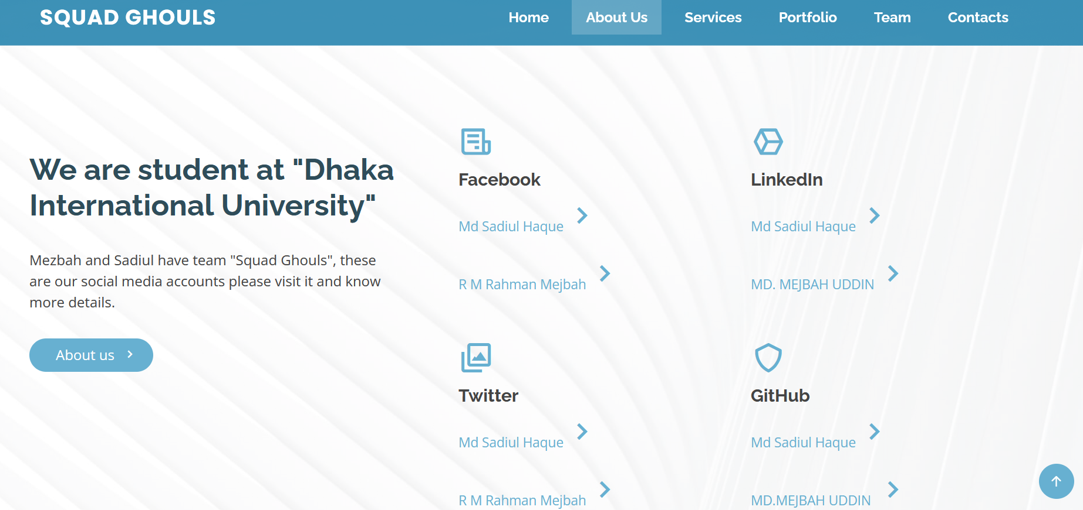
About us

Slide 7

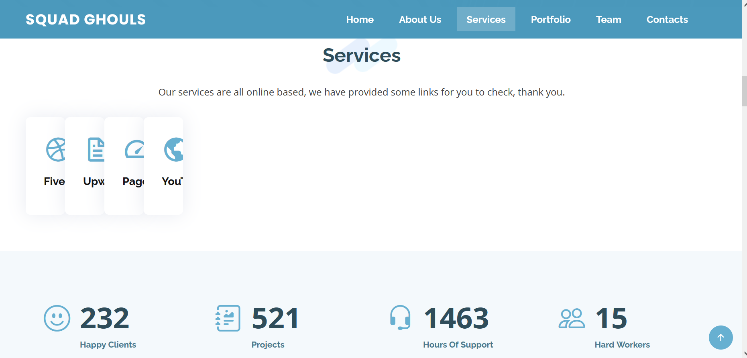
Service

Slide 8

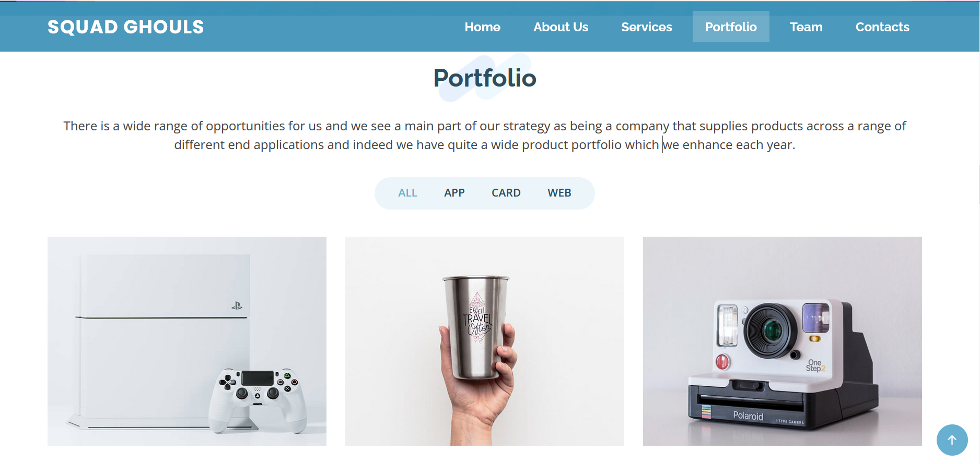
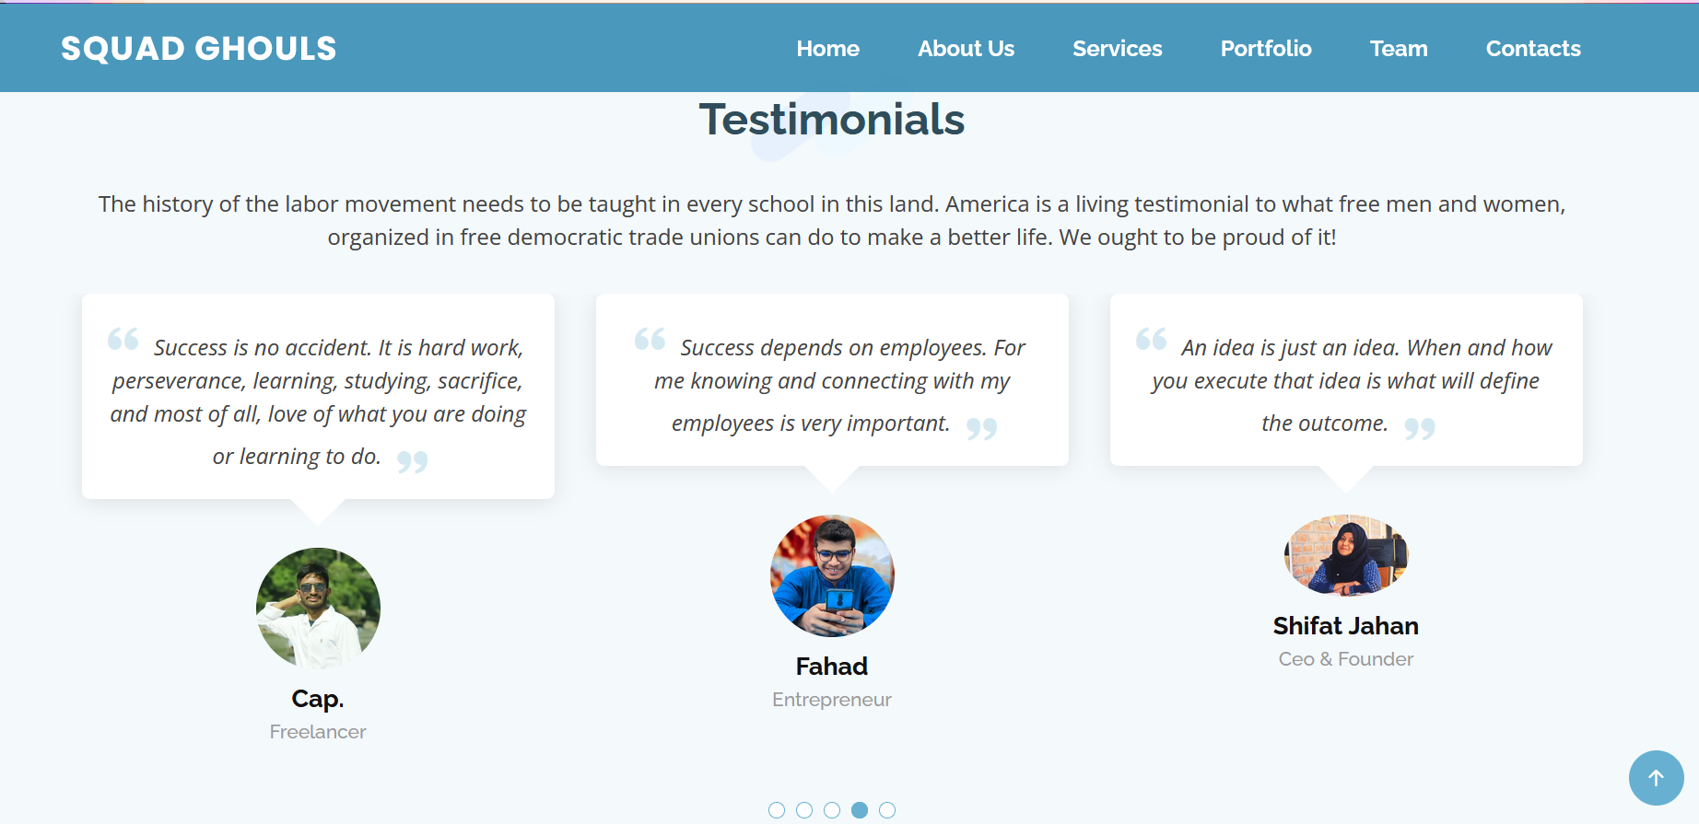
Portfolio

Slide 9

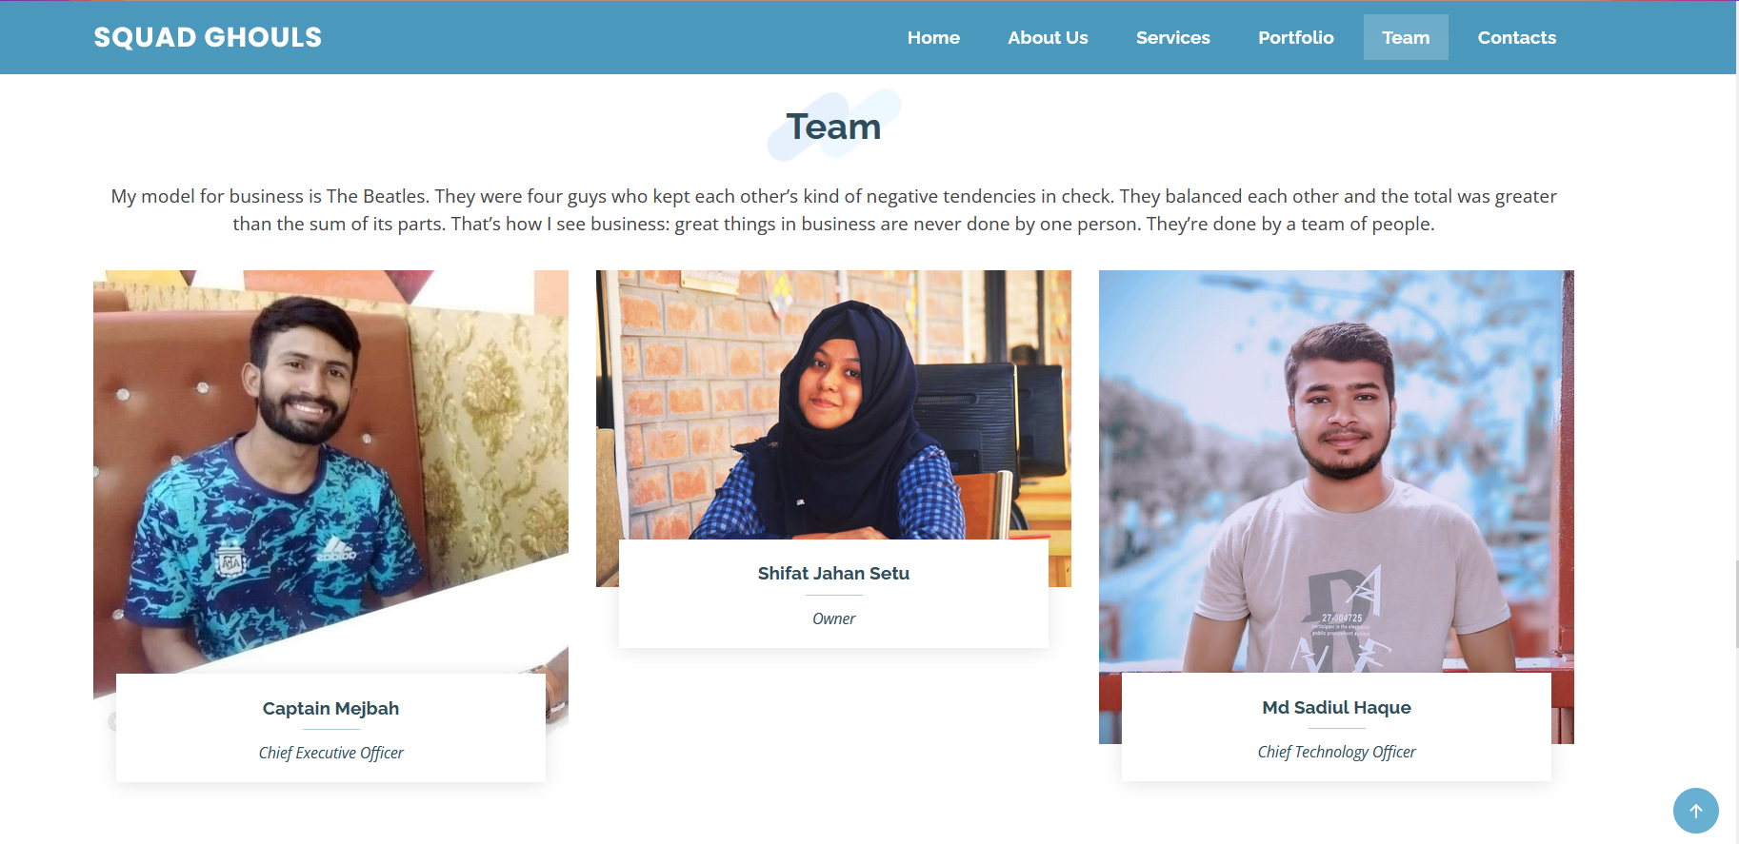
Team

Slide 10

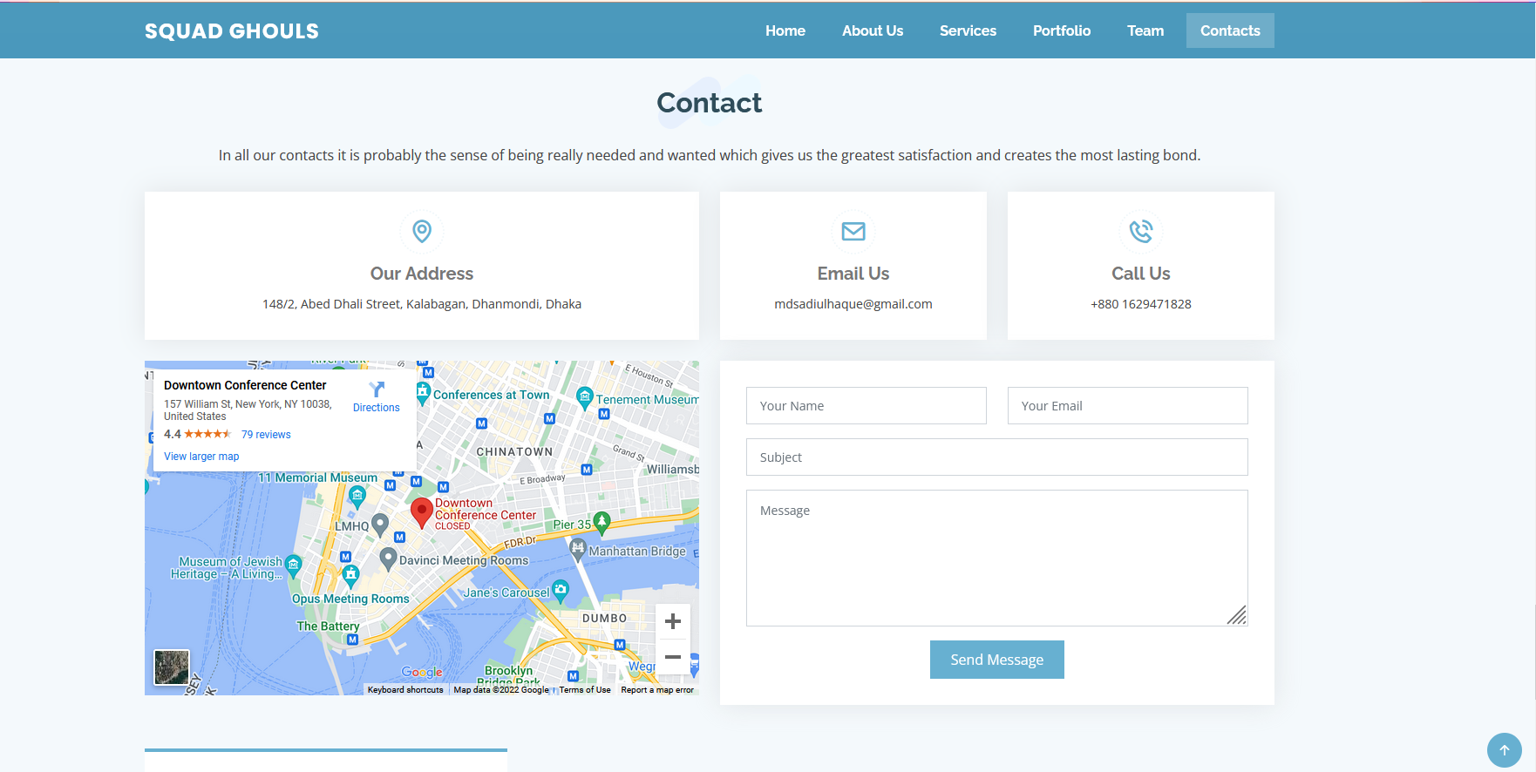
Contacts

Slide 11

Any QUESTION
?

Slide 12

THANK
YOU

